Slide 1
Meccano and Omni wheeled Vehicles

Slide 2
Famous Mobile Robots

Slide 6
Driving Robots

Slide 7
Driving Robots
Driving robots can be:
• 1. Non-Holonomic
• 2. Holonomic (Omni-Directional)
• 3. Wheels
• 4. Tracks

Slide 8
Single Driven Wheel

Slide 9
Types of wheels = vehicles with single driven wheel
Meccano Wheels

Slide 10
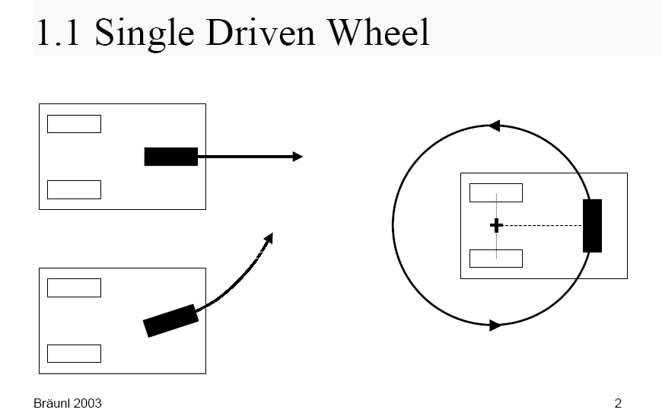
Single Driven Wheel

Slide 11
What is good and bad about this design?

Slide 12
Two Driven Wheels

Slide 13
Two-Wheeled vehicles
Three-wheeled vehicles
Two-wheeled vehicles
Robot Scout
Segway RMP
Scuter Piaggio
Robot Neptun CMU

Slide 14
Robots with 2 wheels and additional support points
Increase of stability

Slide 15
Differential Drives

Slide 16
Differential Drive

Slide 17
What is good and bad about this design?

Slide 18
Example of Differential Drive Design: Robot Eve of Braunl

Slide 19
Another Example of Differential Drive Design: Robot SoccerBot for robot soccer competitions

Slide 20
Another Example of Differential Drive Design: Laboratory wheeled robot LabBot

Slide 21
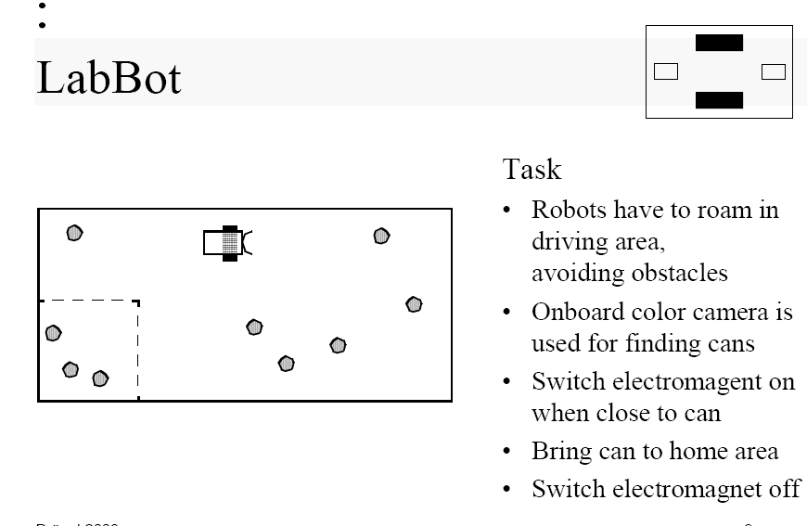

Slide 22
Ackermann Drive

Slide 24
Application of Ackerman Drives

Slide 25
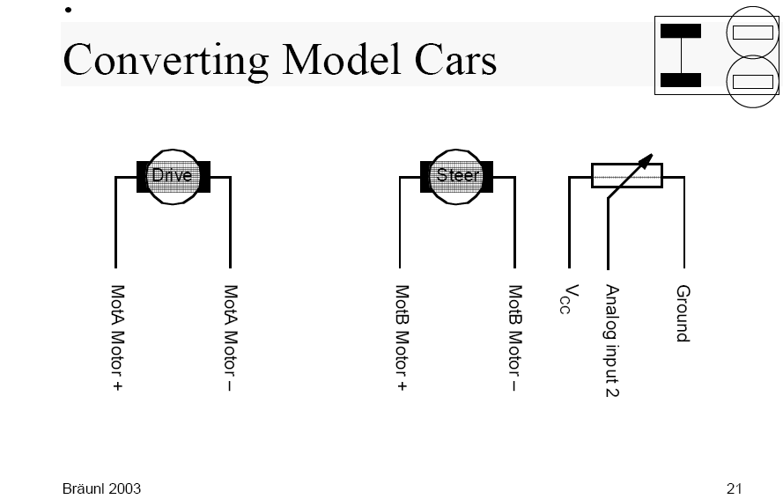
Driving motor A
Steering motor B

Slide 26
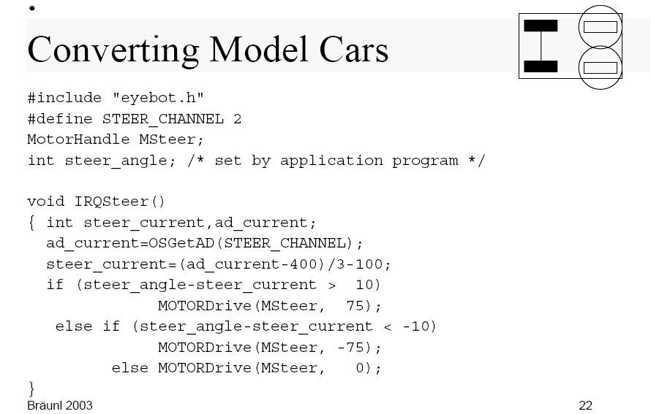
Steering motor control with respect to variable steer_angle

Slide 27
Example of Ackerman Drive Robot: Four Stooges

Slide 28
Three Driven Wheels

Slide 29
Robots with 3 wheels
3 spheric wheels Tribolo

Slide 30
Robots with three wheels

Slide 31
Synchro-Drive

Slide 32
What is good and bad about Synchro-Drives?

Slide 33
Example of Synchro-Drive robot design: XENIA

Slide 34
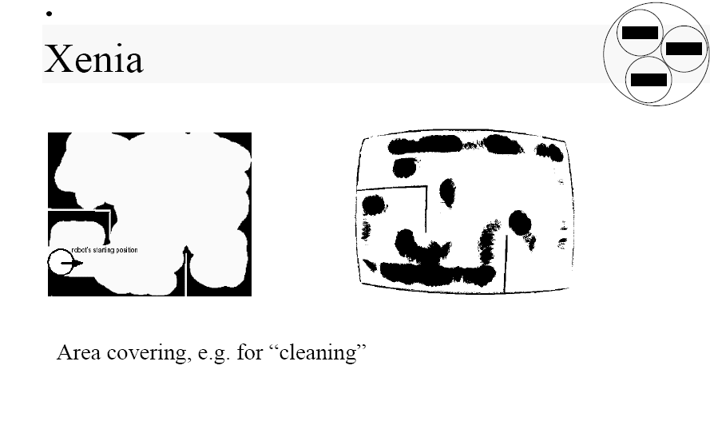

Slide 35
Tracked Robots

Slide 36
What is good and bad about Tracked Robots?

Slide 37
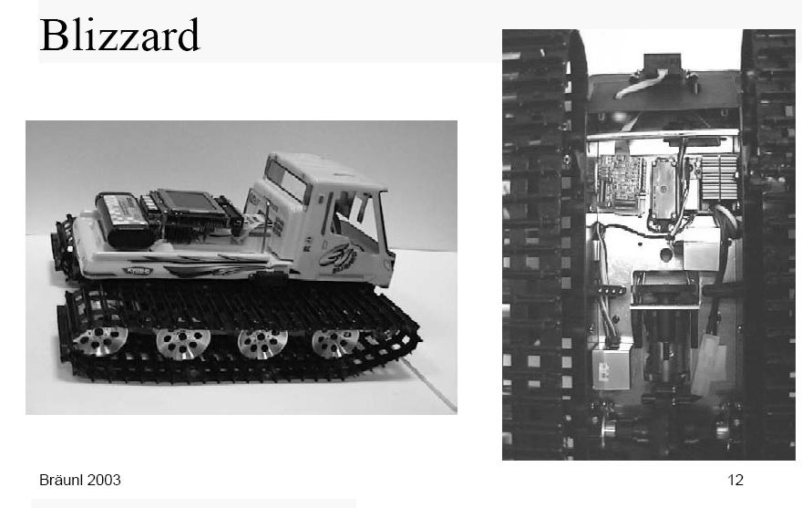
Example of Tracked robot: Blizzard
Reuse your old toys or steal from your kids

